Slide 1
ImageNet Classification with Deep Convolutional Neural Network
GyeongTae Kim

Slide 2
Table of Contents
Abstract
Introduction
ReLU Nonlinearity
Dropout
Results

Slide 3
Abstract
The neural network
Consists of five convolutional layers
used regularization method called “dropout"

Slide 4
Introduction
The way like before doesn’t work
Still have problem with apply on high-resolution images
In conclusion, our network is best.

Slide 5
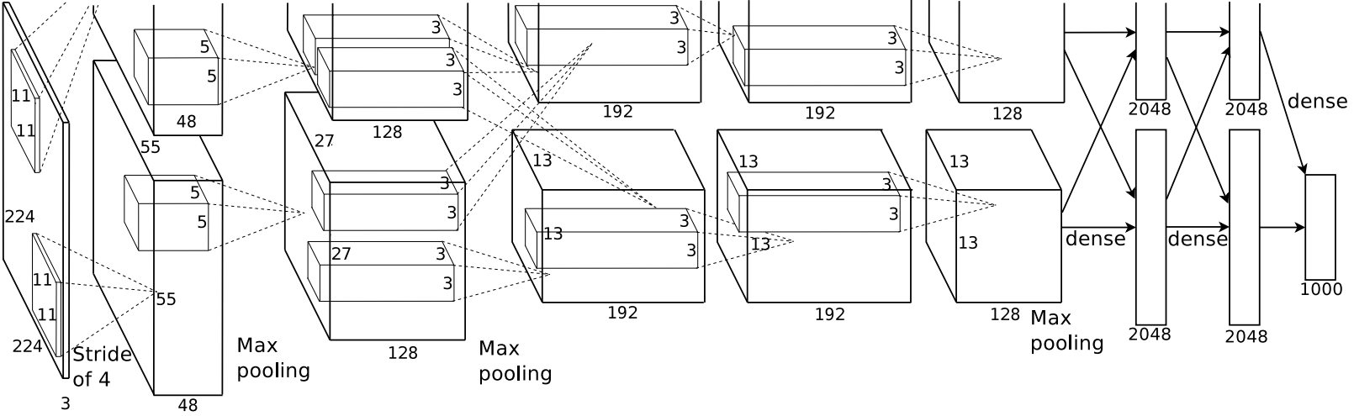
Structure
[Figure 1]

Slide 6
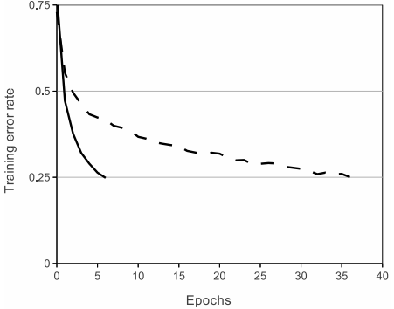
ReLU Nonlinearity
[Figure 2]
Based on CIFAR-10 dataset, showing number of iterations to reach 25% training error .
Tanh vs ReLU?
Solid line - CNN with ReLU
Dashed line - equivalent network with tanh neurons

Slide 7
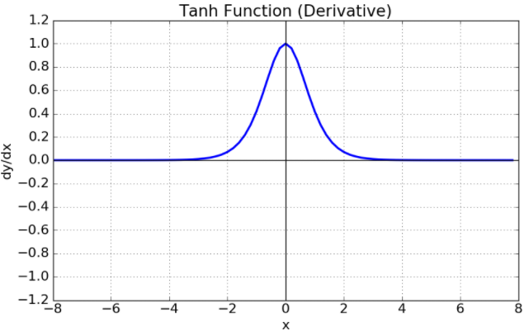
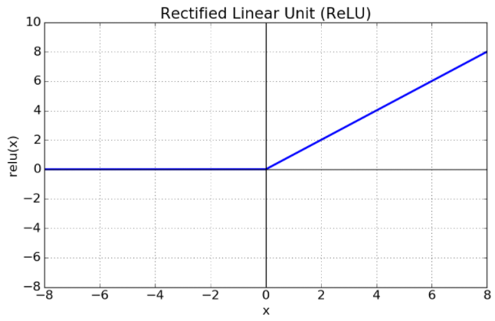
Tanh and ReLU
Hyperbolic tangent function
Solved problem of sigmoid optimization
But with differential function when it is over certain value has gradient vanishing problem
Rectified Linear Unit
The most commonly used Activation function
Compared to sigmoid, tanh function fast

Slide 8
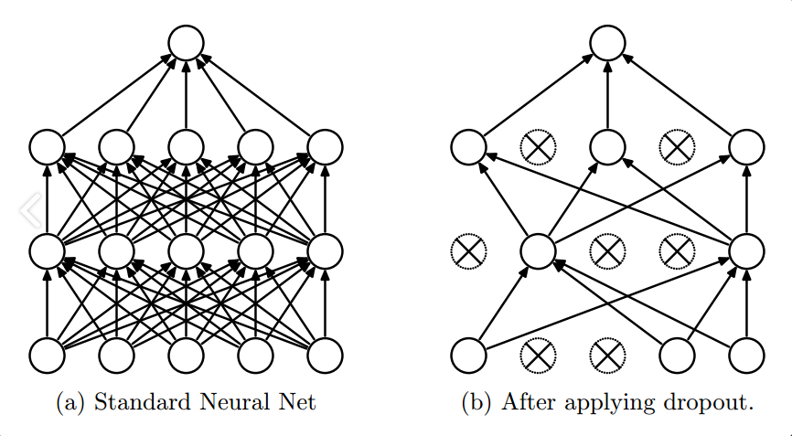
Dropout
Dropout is a popular regularization technique with deep networks
Used dropout in the first two fully-connected layers [Figure 1](page 5)

Slide 9
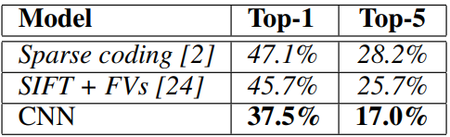
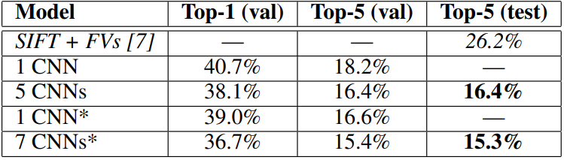
Results
[Table 1]
ILSVRC-2010
[Table 2]
ILSVRC-2012

